Slide 2
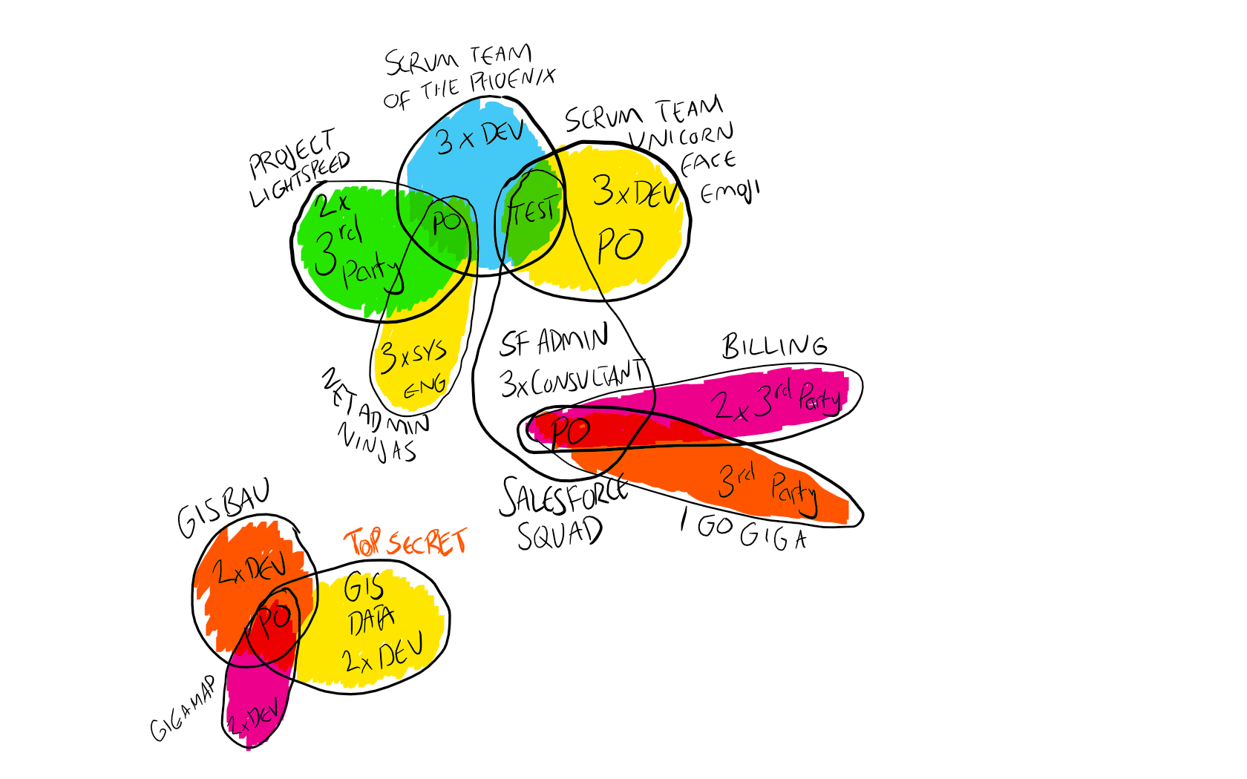

Slide 4
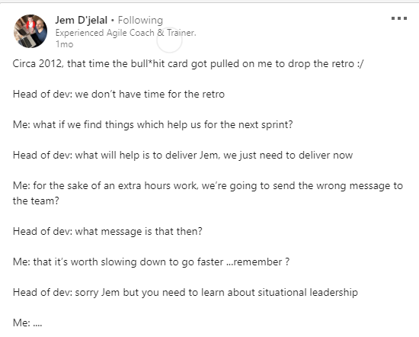
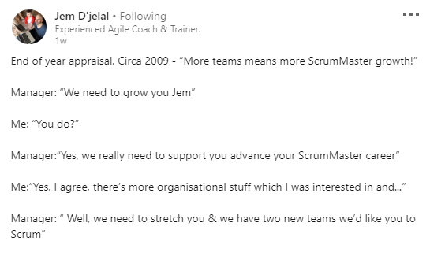

Slide 5
Build projects around motivated individuals. Give them the environment and support they need, and trust them to get the job done.

Slide 6




Slide 7
Individuals and interactions over processes and tools
Working software over comprehensive documentation
Customer collaboration over contract negotiation
Responding to change over following a plan

Slide 9
